Slide 1
Parent Night
MAP 101
Rev. March 2016

Slide 2
Why do we do MAP?
How is it used in the classroom?
How to understand the home report?
What can I do as a parent to help my child?

Slide 3
Purposes of MAP
Measures student growth over time.
Provides a preliminary benchmark of college and career readiness.
Assesses instructional strengths and needs.
Supports differentiated instruction in the classroom.
Projects performance on the PARCC Assessments (future use).
Notes:
Measures growth from year to year and throughout the school year.
Instructional strengths and needs - in conjunction with other measures used in the classroom.
NWEA, the organization that developed MAP, has been developing items that are similar in nature to the PARCC items and those are being field tested in 2014-15. We will have more information after this year’s administration of PARCC about how the MAP scores will be predictive of the PARCC scores.

Slide 4
Notes:
Many of you are aware of the HCPSS Vision 2018 Strategic Plan. The use of MAP is highlighted in the Strategic Plan as a useful tool for teachers to look at student growth and guide instruction.

Slide 5
Notes:
“Goal 1 focuses on Students. Every student achieves academic excellence in an inspiring, engaging, and supporting environment. MAP is identified as one of the Performance Measures. You can see where the performance measures fit into the strategic plan to support Goal 1. Let’s take a closer look at the Performance Measures that are written into the strategic plan.”

Slide 6
Notes:
As you can see, MAP (Measures of Academic Progress) is listed as of the Performance Measures under Goal 1: Students.

Slide 7
October Leadership
Measuring what Matters
Notes:
Some of the measurements on this graphic are familiar – they’ve been in place for a long time and they still offer tremendous value, with the new curriculum.
But most were new – put into place last year or this year.
These measures are all part of one larger picture – these are the measurements that are going to help us deliver on our promise. These are our college readiness measures – which begin in Pre-K.

Slide 8
College & Career Ready Standards Alignment
MAP is aligned to the College and Career Ready Standards
MAP does not have performance-based or constructed-response items (written responses) -- only selected response
Measures Depth of Knowledge (DOK) 1 & 2, and beginning to phase in DOK 3 (SY2016 and SY2017).
Classroom formative assessments are still needed to complement MAP.
Notes:
DOK 1 deals with “recall” – so for example, asking a student to repeat, state, tell, or name. DOK 2 deals with “skill/concept” – so for example, indentify patterns, construct, or predict. These are the areas that MAP currently assesses. In this next school year, DOK 3 items on MAP will be phased in. DOK 3 deals with “strategic thinking” – so for example, apprise, draw conclusions, or cite evidence. MAP has no plans to assess DOK 4, which deals with “extended thinking” – so for example, synthesize, create, apply concepts.
PARCC, as you probably know, will assess DOK 1 through DOK 4. What would be ways you could still assess DOK 3 and DOK 4 in your classroom? (answer: writing tasks, PARCC-like assessments created by curriculum offices, PARCC-like assessments created by you and your team, etc..)

Slide 9
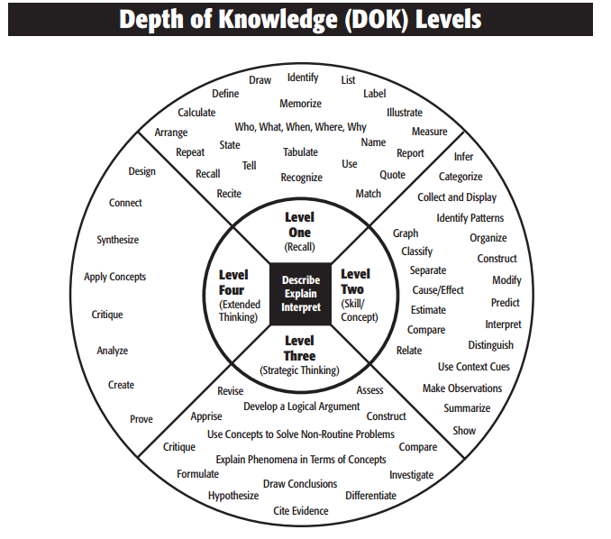

Slide 10
Who takes which MAP?
Grade 1 - MAP for Primary Grades (MPG)
Grade 2 – MAP for Primary Grades (MPG)
students not yet reading at Fluent developmental reading level
OR
Grade 2 – MAP for Grades 2-5
Grade 2 students reading at Fluent developmental reading level
Grades 3, 4, 5 - MAP for Grades 2-5
Grades 6, 7, 8 - MAP for Grades 6+
Algebra I students and beyond are exempt from MAP Math
Notes:
All students in Grades 1 through 8 take MAP. In Grade 1, the MAP for Primary Grades (MPG) is given to all students. In Grade 2, MPG is given to students who are not yet reading at a Fluent Developmental Reading Level. The MPG is read to the students – the students wear headphones. MAP 2-5 and MAP 6+ are not.
Students in Grade 2 who are reading at a Fluent Development reading level are given the MAP 2-5. As are students in Grade 3-5. Students in Grades 6-8 are given the MAP for Grades 6+. All middle school students take MAP in reading. Students who are in Algebra I in middle school can be exempt from the math portion of MAP.

Slide 11
MAP Assessment Information
Two Tests: Math and Reading
MAP is a norm-referenced test.
MAP is a computer-adaptive assessment.
Gives the score as a “RIT”
Notes:
Norm-Referenced Test – MAP is a Norm Referenced Test, which is different from a criterion referenced test. This is another way that MAP differs from other tests that we have given our students in the past. With the criterion referenced test, students are only given items that meet a certain criterion, which often times is the grade level criterion. For example, on MSA, students in 5th grade are given items that come from the 5th grade curriculum. With MAP, as the student goes through the test, they will might see items that are outside of their grade level. This is something to be aware of because some might ask why they are seeing concepts that they have not yet been taught. Again, this gives us, as educators, an idea of what students might be capable of handling in the classroom.
Computer Adaptive Assessment - In a computer adaptive assessment, the difficulty of the questions adjusts so that each student takes a unique test. The difficulty of the question is based on how well the student has answered the previous question. As the student answers questions correctly, the subsequent question will be more difficult. The reverse is also true. The graphic on the next slide visually depicts this.

Slide 12
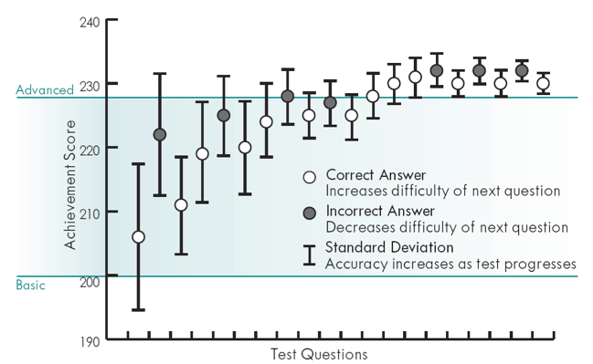
MAP is Computer Adapted
First question is at the median level for that particular grade. As the test progresses, it will get better at identifying the appropriate level for each student.
Notes:
This graphic shows how the computer adapts as a student responds to the test questions.
The first time a student takes MAP (in the Fall), the first item the student gets is an item of “average” difficulty for that grade. As you can see here, the first item the student got was around an item difficulty of 208. The student got that item correct, and so the next item was more difficult, around a 221. The student got that item incorrect, so the third item was around a 211 – harder than the first, but easier than the second. It continues in this way until the test is over.
The next time the student takes MAP (in the Winter), the test picks up where it left off from the previous time.

Slide 13
What is a RIT?
RIT stands for Rasch unIT
Equal-interval scale
Measures growth over time
Independent of grade level
“A RIT is a RIT is a RIT”
Notes:
An equal interval scale means that each unit is the same “size.” It is kind of like a yard stick – each inch is the same size. So the distance between a RIT of 220 and 225 is the same distance (growth) is the distance between a 190 and a 195.
NWEA specifically choose to use the RIT, so that they could look at growth over time. The RIT was developed specifically to look at growth.

Slide 14
Not your grandfather’s statistics
Notes:
In case you are wondering, here is the Swedish mathematician, Georg Rasch, who developed the Rasch Unit.

Slide 15
RIT
Percentile Rank
Notes:
One of the aspects that has made MAP tricky for people to understand is that the score is given as a RIT. The RIT is just a number and it has no context or inherent meaning to it. Think of it this way. The SAT score is just a number, but once you put a context to the number, for example that you need a 550 on the Verbal to take a credit-bearing class in college, now the number has meaning. The way to make meaning with the RIT is to add context, and the Percentile Rank is what that does for you.
Some people get confused with Percentile Rank. So we’ll do a short Stats 101 review about Percentile Rank ☺ so we’re all on the same page. We’ve also found that using these explanations helps with understand MAP better.
Ask - So when we talk about Percentile Rank, what do you think people get confused about? (wait time)
Answer - They think “percentage.”
Ask - So what’s the difference?
Answer – percentage tells you how many out of the total the student got correct. “Johnny got 8 out of 10 correct, or 80%.” But the percentile rank tells you how the student performed in relation to the other students. “Johnny was in the 75th-percentile, meaning he scored better than 75% of the other 10 year olds. Being in the 75th-pecentile is pretty good, right?”
Sometimes explaining it to parents as it relates to taking their child to the pediatrician helps percentile rank make sense to them.

Slide 16
Percentile Rank and Height of 18 month olds
34 inches
33 inches
32 inches
31 inches
5th 15th 25th 35th 50th 65th 75th 85th 95th
Notes:
So when you bring your child to the pediatrician for their check up, the doctor will measure and weigh your child. If your child happens to be really tall, he/she may be in the 80th-percentile. That just means that he/she is taller than 80% of other children of that same age.

Slide 17
“Where is my Child’s Score on the MAP Report?”

Slide 18
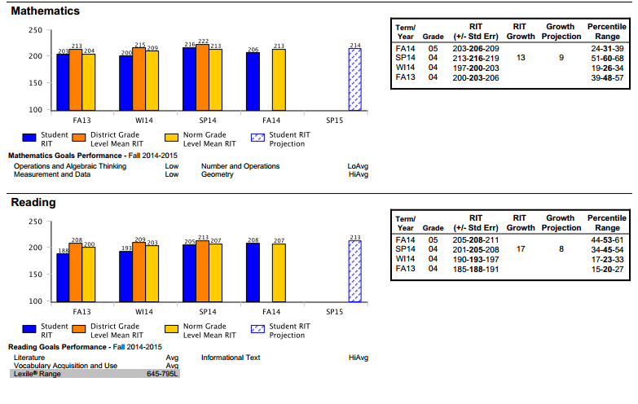
Notes:
On the graph – Your child’s score is the darkest shaded bar (in blue on the power point) labeled “Student RIT.” Each time your child takes MAP, a new bar will be added to the graph, along with the bars showing assessment results from previous MAP administrations.
In the box – Your child’s score is the bolded number in the third column, labeled “RIT.” In the last column, labeled “Percentile Range,” the bolded number is your child’s percentile rank on the assessment. The box also contains your child’s scores from any previous MAP administrations.

Slide 19
“How can I help my child?”

Slide 20
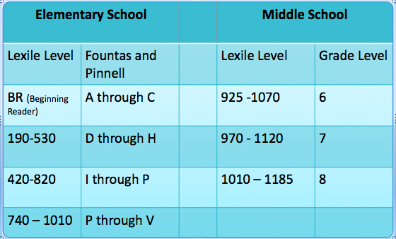
Lexile Aligned with Fountas & Pinnell and Grade-Level Reading

Slide 21
“How did my child do on MAP?”
Percentile Rank
Look in the box on the right and find your child’s percentile range. This tells you how your child scored in comparison with other students in the same grade, across the country who took the MAP assessment.
The child scored in the 53rd percentile for Reading. This means the child scored as well as or better than 53% of other 5th graders across the country on reading who took MAP.
Notes:
“If we lined up 100 5th graders from the highest score to the lowest score who took MAP, your child would be 53rd in line.”
“The percentile rank is like when you take your child to the pediatrician and they tell you that your child is in the 53rd percentile for height, meaning he is as tall or taller than 53 percent of the other children his age.”

Slide 22
“How did my child do on MAP?”
Graph
Look at the graph to determine if your child’s score has increased each time he or she has taken the MAP assessment. (for returning MAP schools)
Look at how your child compares with same grade peers within HCPSS (orange bar); across the country (yellow bar)

Slide 23
“How did my child do on MAP?”
The Mathematics and Reading Goal Performance (at the bottom of each graph) give more detailed information about how your child performed in the areas assessed on MAP.
The student performed “Average” in Literature and Vocabulary Acquisition and Use and “High Average” in Informational.
Notes:
If the question comes up, the following percentile ranks go with each descriptor:
High 81st percentile – 99th percentile
HiAvg 61st percentile - 80th percentile
Avg 41st percentile – 60th percentile
LoAvg 21st percentile – 40th percentile
Low 1st percentile – 20th percentile

Slide 24
“How MAP fits with other pieces of information?”
“It is important to remember that MAP is one piece of information and should always be used and understood together with the other pieces of information collected on your child, such as classroom-based information, tests, quizzes, classwork, homework, etc..”
“Remember that MAP is multiple choice and does not include a writing component. To have a full picture of your child’s academic skills, it is important to include all components of his/her progress and skills.”
Notes:
The focus of the conference should be on all of the information on the student, with MAP being one piece.

Slide 25
“What can the parent/family do to support the child?”
General
Make sure your child regularly attends schools so he/she can learn what is needed to be successful in school.
Provide a quiet place at home for your child to do homework assignments that reinforce what he/she is learning in school.

Slide 26
“What can the parent/family do to support the child?”
MAP
Remind your child that there is no time limit to the MAP assessment and to take his/her time.
Discuss the MAP scores with your child. Discuss it with your child in a HOPEFUL way. Talk about what they did well. Ask them what they are proud of in their scores and where they want to improve next time.

Slide 27
“What can the parent/family do to support the child?”
Help your child select books at his/her independent reading level. The Lexile® Range for your child can be found at the bottom left of the reading graph. The Lexile® Range provides the readability of text based on the length of the words and sentences. These ranges correspond to the Fountas and Pinnell leveled books used in our elementary classrooms for reading instruction. (See comparison tables in the next slide.)
The ranges and levels should not be the determining factor in selecting reading materials for your child. Not all books have these designations, and it is important to choose topics and formats that are age appropriate and interesting to your child.

